Slide 1
Deep Learning for finance Machine Learning
Pablo-Manuel Calderón Gómez
2018

Slide 2
Machine Learning
Index
Scope
Logistic classifier (Linear model)
Multinomial logistic classification
One-Hot encoding
The Softmax function
Cross Entropy
Minimizing Cross Entropy
Gradient Descent
Normalized inputs (numerical stability)
Parameters initialization
Rectified Linear Units (RELU)
Artificial Neural Network - Perceptron
Network signal propagation
Backpropagation
Deep Neural Network
Early Termination
Regularization
Dropout
Dropout – Inverted dropout

Slide 3


Machine Learning
Scope
This presentation has been prepared with different internet information sources but mainly is based on two courses from Udacity (https://www.udacity.com/):
Deep Learning
Machine Learning for Trading

Slide 4
Machine Learning
Logistic classifier (Linear model)
The linear model is defined by the equation: y=w·x+b.
The matrix of coefficients W has K rows and N columns.
The number of rows K is the number of classes defined.
The number of columns N is the number of inputs or parameters.
The bias matrix is just 1 column of K rows.
The prediction has the dimension K.
Therefore the total number of parameters is: K·N+K = K·(N+1)
Linear model
W
·
X
+
B
=
Y
Parameters (N)
W11
W12
…
W1n
X1
B1
Y1
W21
W22
…
W2n
X2
B2
Y2
Classes (K)
W31
W23
…
W3n
·
X3
+
B3
=
Y3
…
…
…
…
…
…
…
Wk1
Wk2
…
Wkn
Xn
Bk
Yk
Weights
Inputs
Bias
Prediction

Slide 5
Machine Learning
Multinomial logistic classification
The multinomial logistic classification applied to the input values provides the more statistically representative class.
The process to estimate the class is:
Apply the linear model to the inputs.
Softmax function (S) is applied to the Logit scores (Y).
Apply Cross Entropy to generate Hot Label.
Identify the class from Hot Label.
We want to turn the logit scores into probabilities. The probability of the correct class is going to be close to 1 and the rest close to 0.
We will use a Softmax function to turn the scores into probabilities.
Inputs
X
Logit Score
Y
Softmax
S(Y)
Hot Label
L
Class
X1
Linear Model
W·X+b
Cross Entropy
D(S,L)
2.3
S(Y)
0.0289
0
X2
5.8
0.9569
1
X3
0<p<=5
0.2
0.0035
0
…
1.3
0.0106
0
Xn
Σ=1

Slide 6
Machine Learning
One-Hot encoding
One-hot is a group of bits among which the legal combinations of values are only those with a single high (1) bit and all the others low (0).
We use the one-hot encoding to define the classes. Each class will be unique and defined as a vector of zeros with only one 1.
In our analysis we define 4 classes depending on the profit in pips (r):
The training process will define the values of the parameters (coefficients and bias) which are good at performing the predictions.
p<0
0<p<=5
5<p<10
p>=10
1
0
0
0
0
1
0
0
0
0
1
0
0
0
0
1

Slide 7
Machine Learning
The Softmax function
The Softmax function, or normalized exponential function, is a generalization of the logistic function that "squashes" a K-dimensional vector y of arbitrary real values to a K-dimensional vector S(y) of real values in the range [0, 1] that add up to 1.
*For i=1 to K.
Logit scores Softmax function Probabilities
Main concepts:
Inputs can be any kind of scores.
Probabilities add up to 1.
Probabilities will be larger when scores are large.
Probabilities will be small when scores are comparatively smaller.

Slide 8
Machine Learning
Cross Entropy
We can measure the error by comparing two vectors; the probabilities that comes out of the Softmax function and the one hot encoded vector that corresponds to the classes defined.
It is selected the class with lower Cross Entropy (lower distance error).
Softmax
S(Y)
0.0289
Hot Label
L
p<0
0.9569
1
0
0
0
0.0035
0
1
0
0
0<p<=5
0.0106
0
0
1
0
Σ=1
0
0
0
1
5<p<10
p>=10

Slide 9
Machine Learning
Minimizing Cross Entropy
The objective is to find the optimum weights W and biases B that will provide the best classification. This means the classifier have to provide a low error for the correct class but have a high error for the incorrect class.
We define the training loss as the Average Cross-Entropy over the entire training set. A top classifier will provide the minimum cross-entropy for each data of the training set.
The training loss is a function of weights and biases. We are going to minimize that function which is a numerical optimization.
There are several ways to solve a numerical optimization. The simplest way is gradient descent.

Slide 10
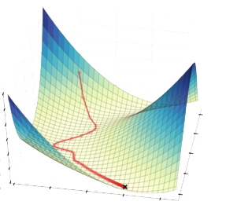
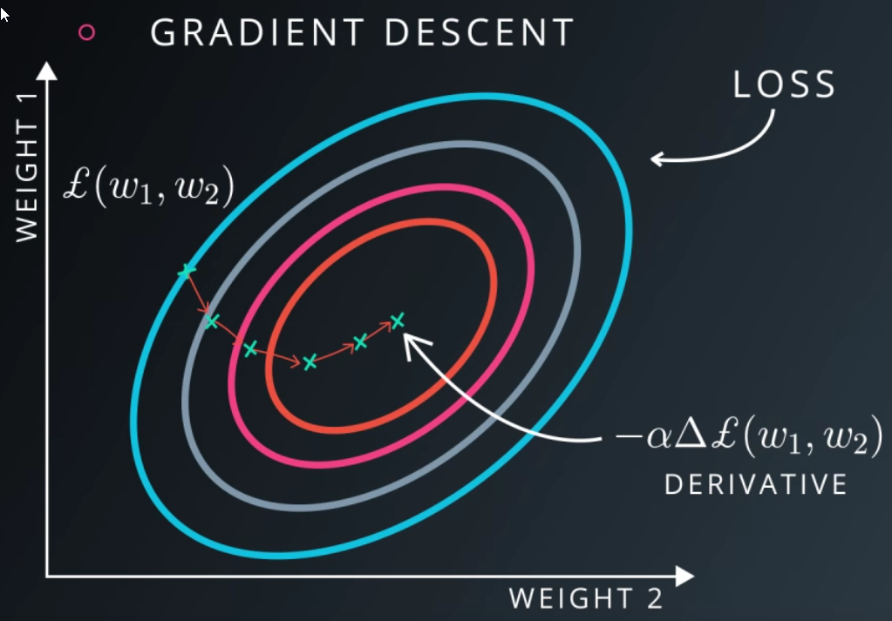
Machine Learning
Gradient Descent
Gradient descent is an iterative method that is given an initial point, and follows the negative of the gradient in order to move the point toward a critical point, which is hopefully the desired local minimum.
Take the derivative of the loss with respect to each parameter and follow the derivative by taking a step backwards and repeat until you get to the bottom.

Slide 11
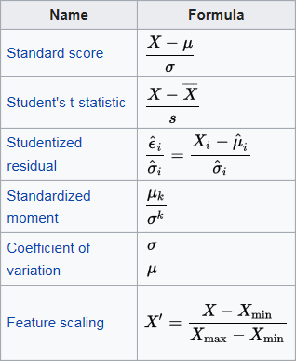
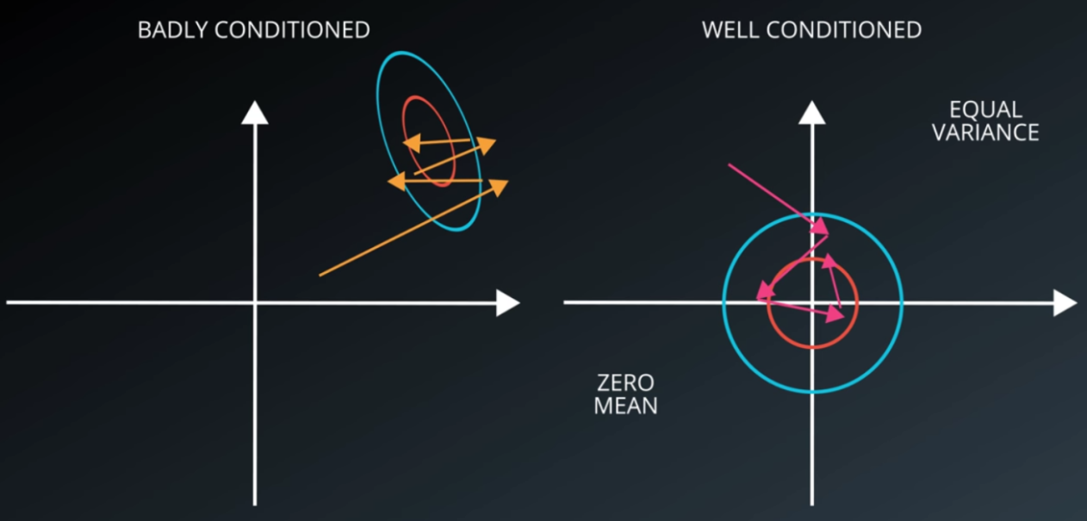
Machine Learning
Normalized inputs (numerical stability)
There are mathematical reasons to keep values to compute roughly around a mean of zero and equal variance when doing optimization.
A badly conditioned problem means that the optimizer has to do a lot of searching to go and find a good solution.
A well condition problem makes it a lot easier for the optimizer to do its job.
Adding very small numbers to very large numbers can introduce errors.
There are various normalizations:

Slide 12
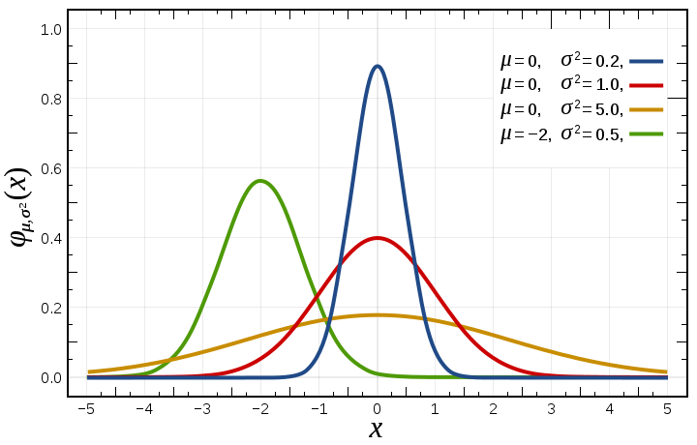
Machine Learning
Parameters initialization
To start the optimization we need to define the initial values for the parameters W and B. In general we will generate random parameters with a normal distribution.
Large sigma values will mean we will have a wider distribution. As we applied the Softmax function this means higher peaks of probability (the initialization will be biased and inflexible).
Small sigma means the distribution is very uncertain.
In general it is better to start with an uncertain distribution (small sigma) and let the optimization to become more confident as the training progress.

Slide 13
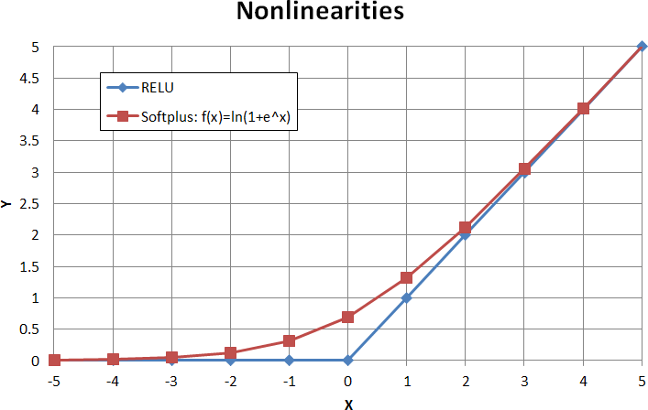
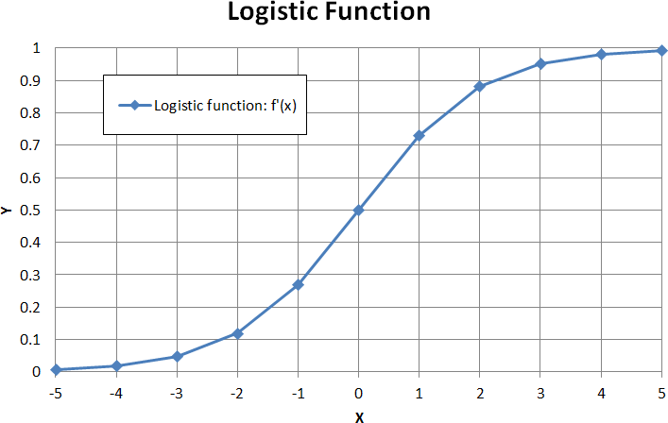
Machine Learning
Rectified Linear Units (RELU)
The Multinomial Logistic Classification has some limitation because is based on linear models (Y=X₁+X₂).
We won’t be able to model efficiently the non-linear relations (Y=X₁·X₂).
Rectified Linear Units are the simplest non-linear functions.
A smooth approximation to the rectifier is the softplus function: f(x)=ln(1+e^{x}). The derivative of softplus is the logisitc function (f’(x)).

Slide 14
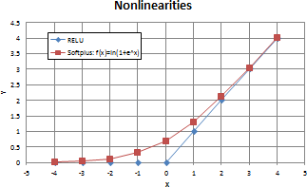
Machine Learning
Artificial Neural Network - Perceptron
We introduce the nonlinear effect thanks to the RELUs in the middle of the two linear models. There is a new parameter H which corresponds to the number of RELU units we have in the classifier.
Inputs
X
RELUs
H
Logit Score
Y
Softmax
S(Y)
Hot Label
L
Class
X1
1st Linear Model
W₁·X+b₁
2nd Linear Model
W₂·X+b₂
Cross Entropy
D(S,L)
2.3
S(Y)
0.0289
0
X2
5.8
0.9569
1
X3
0.02<r<0.05
0.2
0.0035
0
…
1.3
0.0106
0
Xn
Σ=1
The Perceptron (or Artificial Neuron) performs two operations.
Adds products of weights and inputs.
Apply the non-linear function.
Inputs
X
Perceptron (Artificial Neuron)
X1
W₁
Non-linear function
X2
W₂
Summing function
X3
W₃
Y=f(e)
…
W_{n}
Xn

Slide 15
Machine Learning
Network signal propagation
The input signals feeds the input layer. Then signals propagates through hidden layers to the output layer.
The output signal of the network (y) is compared with the desired target value (z) of the training set. The difference is called error δ of output layer (δ=z-y).
It is not possible to compute the signal error of the internal neurons, because output values of these neurons are unknown.
Inputs
Input Layer
Hidden Layer
Output Layer
N1
W_{N1-N4}
Input Layer
W_{X1-N1}
X1
N4
W_{N4-N6}
W_{X2-N1}
N2
N6
Y
Hidden
Layer
X2
N5
N3
Output Layer

Slide 16
Machine Learning
Backpropagation
Backpropagation is the method used to calculate the error contribution of each neuron.
The weight coefficients used to propagate error back are equal to this used during computing output value. Only the direction of the flow is changed.
When the error signal for each neuron is computed, the weights coefficients of each neuron input are modified.
Where f’(e) is the derivative of the neuron activation function.
Coefficient η affects network teaching speed
Inputs
Input Layer
Hidden Layer
Output Layer
δN1
Output Layer Error
N1
δN4
Hidden Layer Backpropagation error
X1
δN2
N4
δ
N2
δN5
N6
Y
Input Layer Backpropagation error
X2
δN3
N5
N3

Slide 17
Machine Learning
Deep Neural Network
The neural network can be more complex by:
Increasing the number of neurons of the hidden layers.
Increasing the number of hidden layers.
Increasing the number of neurons is not very efficient in general because we need to add a very high number of neurons and it gets really hard to train.
The central idea of deep learning is to increase the number of hidden layers instead of increasing the number of neurons. We make the model deeper.
Artificial Neural Network
Deep Neural Network
Inputs
Input Layer
Hidden
Layer
Output Layer
Deeper model
N1
Inputs
Input Layer
Hidden
Layer 1
Hidden
Layer 2
Hidden
Layer 3
Hidden Layer 4
Output Layer
N2
Ni1
N11
N21
N31
N41
Ni1
X1
N3
X1
Wider model
Ni2
N12
N22
N32
N42
Out
Y
Ni2
N4
Out
Y
X2
X2
Ni3
N5
Ni3
N13
N23
N33
N43
N6

Slide 18
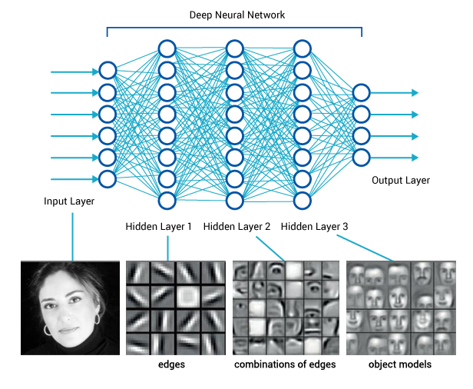
Machine Learning
Deep Neural Network
Reasons to go deeper:
Parameter efficiency: we get much more performance with fewer parameters by going deeper rather than wider.
A lot of nature phenomena tend to have a hierarchical structure which deep models naturally capture.
Deep neural models are effective if we have enough data to train them.

Slide 19
Machine Learning
Early Termination
The network that’s just the right size for your data is very hard to optimize. We always try networks that are too big for the data and try to prevent overfitting.
A method to prevent the over optimization is the Early Termination. We stop training the model as soon as we stop improving the performance.
When a model is over fitted, the train error is smaller but the error of the test data is bigger.
Validation set performance
Error
Overfitting
Overfitting
Stop train
Stop train
Test error
Train error
Training time
Training time

Slide 20
Machine Learning
Regularization
Regularization is the process of introducing additional information to solve a problem or to prevent overfitting. Regularizing means applying artificial constraints on the network.
A regularization term R(f) is added to the lost function:
There are different forms of regularization. We are going to focus on the p-norm (also called l_{p}-norm) as a regularization method:
For p=1 we get the Taxicab norm:
For p=2 we get the Euclidean norm:

Slide 21
Machine Learning
Regularization
One of the most common forms of regularization is the Tikhonov regularization also known as ridge regresion (L2):
We use a small constant λ multiplied by the weight coefficients of the Deep Neural network to calculate the regularization.
The parameter λ controls the importance of the regularization term.
The regularization term penalizes large weights which helps to solve the network and prevents overfitting.

Slide 22
Machine Learning
Dropout
Dropout is a regularization technique for reducing overfitting in neural networks by preventing complex co-adaptations on training data. It is a very efficient way of performing model averaging with neural networks.
Dropout basically removes randomly a proportion of the nodes of the layers. This actually removes the ingoing and outgoing links of that nodes (activations). It just destroy a proportion of the data that’s flowing through the network.
After applying the dropout (crossed nodes have been dropped):
Process description:
Randomly drop a proportion of the nodes of each layer.
Apply inverted dropout factor to activations (divide by keep probability).
Iterate the network through the entire train data set.
The next iteration of the gradient descent, same proportion of the nodes per layer are dropped randomly again.
Repeat steps 2 and 3 until network converges to a solution.
Inputs
Input Layer
Hidden
Layer 1
Hidden
Layer 2
Hidden
Layer 3
Hidden Layer 4
Output Layer
Ni1
X
N21
N31
X
X1
X
N12
X
X
N42
Out
Y
X2
Ni3
X
N23
N33
N43

Slide 23
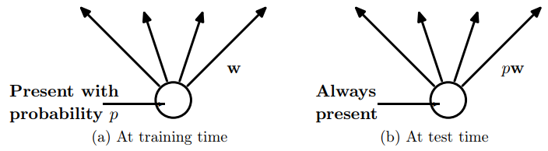
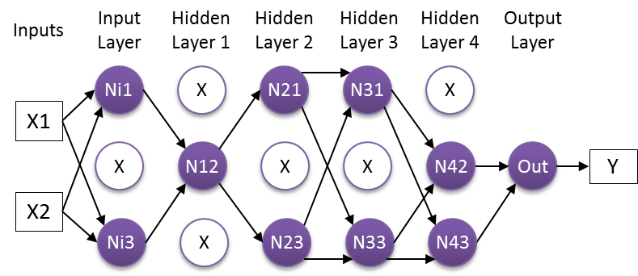
Machine Learning
Dropout
The network can never rely on any given node to be present. It is force to learn a redundant representation for everything to make sure at least some of the information remains.
Dropout makes the network solution more robust and prevent overfitting. It acts as if taking a consensus over an ensemble of networks which is always a good way to improve performance.
Inverted dropout
At test time we don’t use dropout because we don’t want the output to be random. Dropout in the test time just add noise to the predictions.
Therefore only during train phase, the activations are divided by the keep probability factor to counteract the effect of having less nodes.
In the example:
We drop 6 nodes out of 15
Drop probability is 6/15=0.4.
Therefore keep probability is 9/15=0.6
During train time the activations must be divided by 0.6.
During test time no factor is applied to activations.

